Slide 1

TDA Presentation
By Elvis Kimara

Slide 2
Problem Definition
How can we bring topological data analysis into deep neural networks and use it as a viable method for shape reconstruction.
We care because we want to extract zero dimensional features using persistent diagrams to get traits that are most prevalent
Our research question is: can this method help mitigate the problem of ghost geometries during shape reconstruction

Slide 3

My Role
Run multiple jobs with different losses, and networks to test our methodology

Slide 4

Methodology
Use TDA losses like: combo_1_wasserstein
combo_2_wasserstein
combo_1_2
combo_1_2_wasserstein
wasserstein
And enforce TDA in MLP.

Slide 5

Papers Read
Implicit Geometric Regularization for Learning Shapes
Divergence guided shape implicit neural representation for unoriented point clouds
Topology-controllable Implicit Surface Reconstruction Based on Persistent Homology
Neural Splines- Fitting 3D Surfaces With Infinitely-Wide Neural Networks

Slide 6
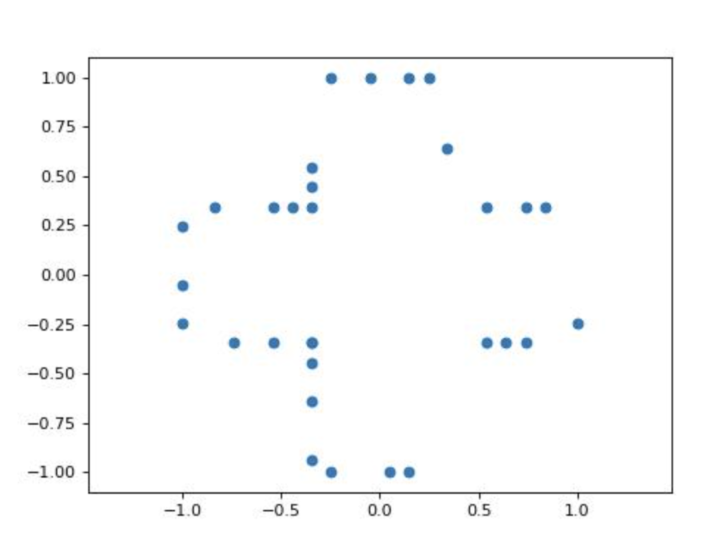
Input Data

Slide 7
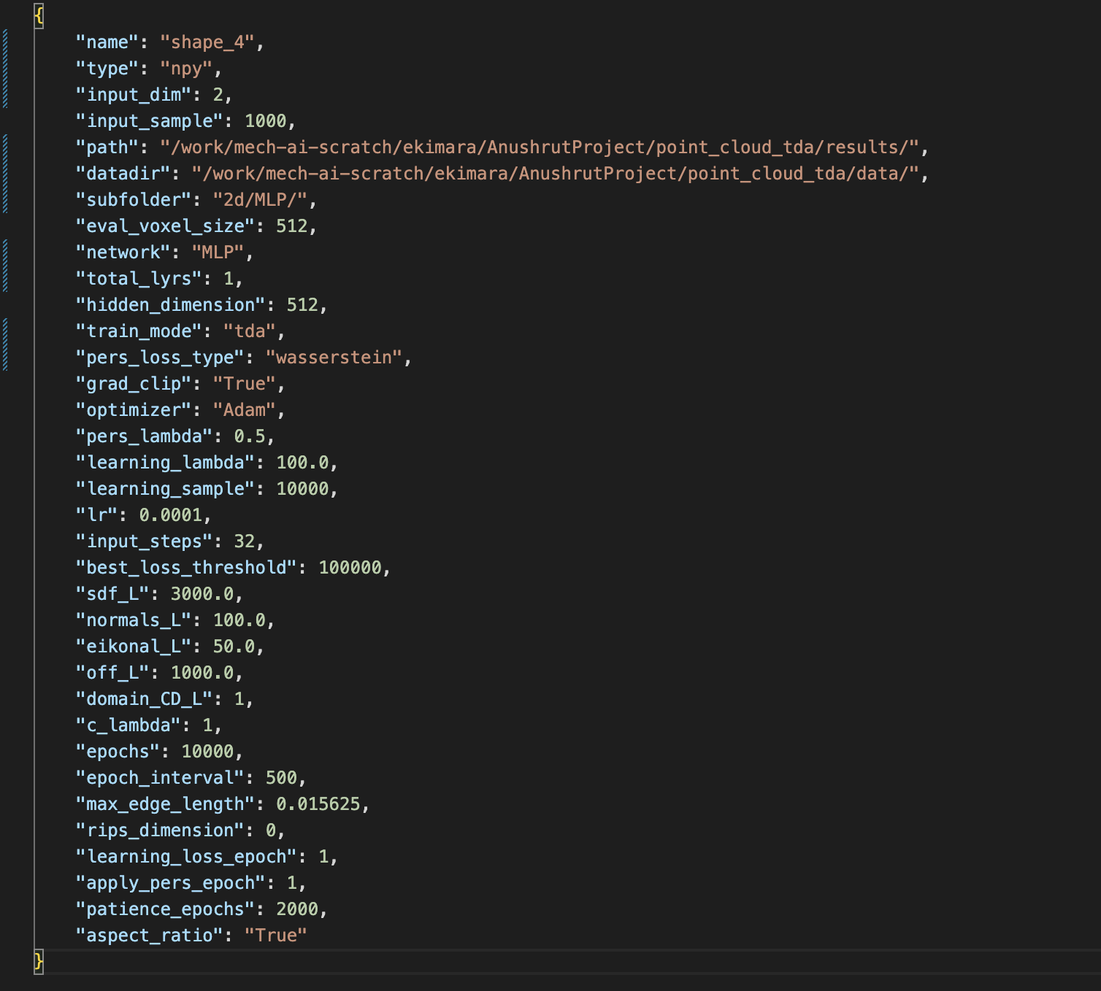
Scripts

Slide 8
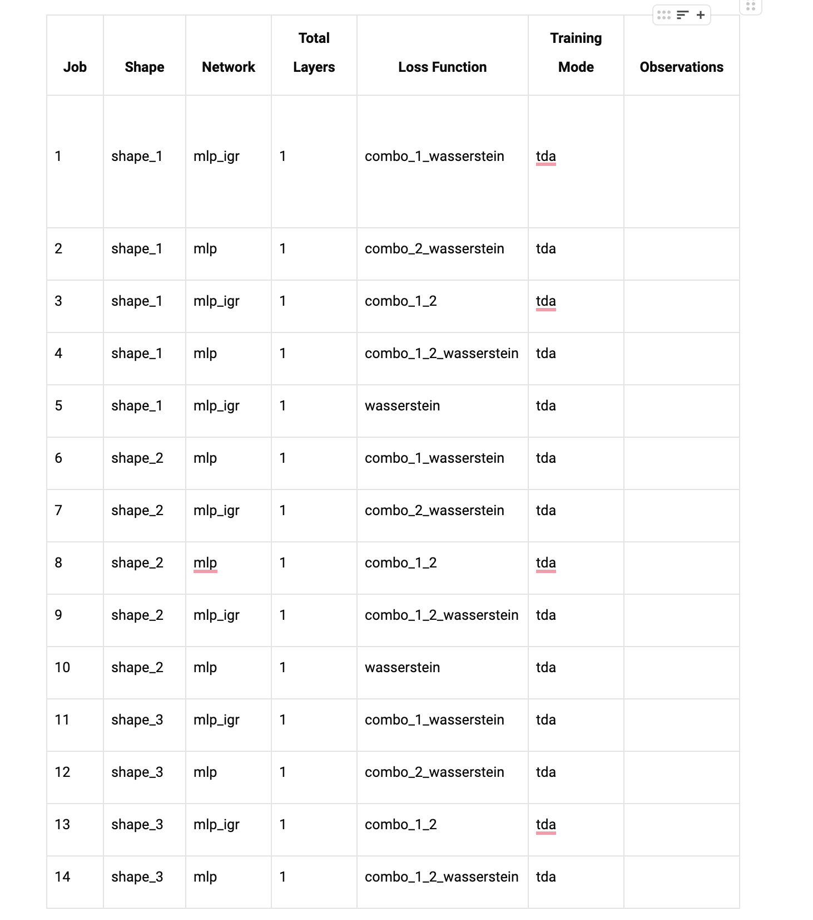
Jobs to Run

Slide 9
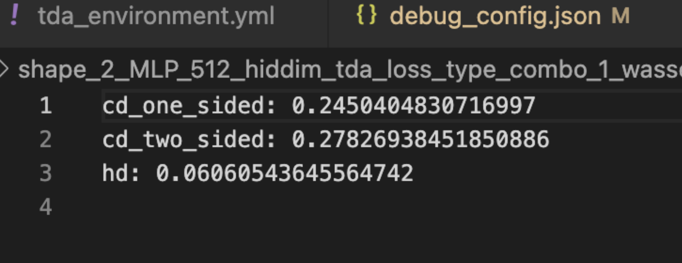
Table of Losses

Slide 10
Next steps
Run jobs that enforce homology based on the paper: Topology-controllable Implicit Surface Reconstruction Based on Persistent Homology

